Slide 1


When Shall I Estimate Your Intent?
Costs and Benefits of Intent Inference in Multi-Agent Interactions
Sunny Amatya, Mukesh Ghimire, Yi Ren, Zhe Xu, and Wenlong Zhang
Robotics and Intelligent Systems Laboratory,
The Polytechnic School,
Arizona State University
June 8th, 2022

Slide 2

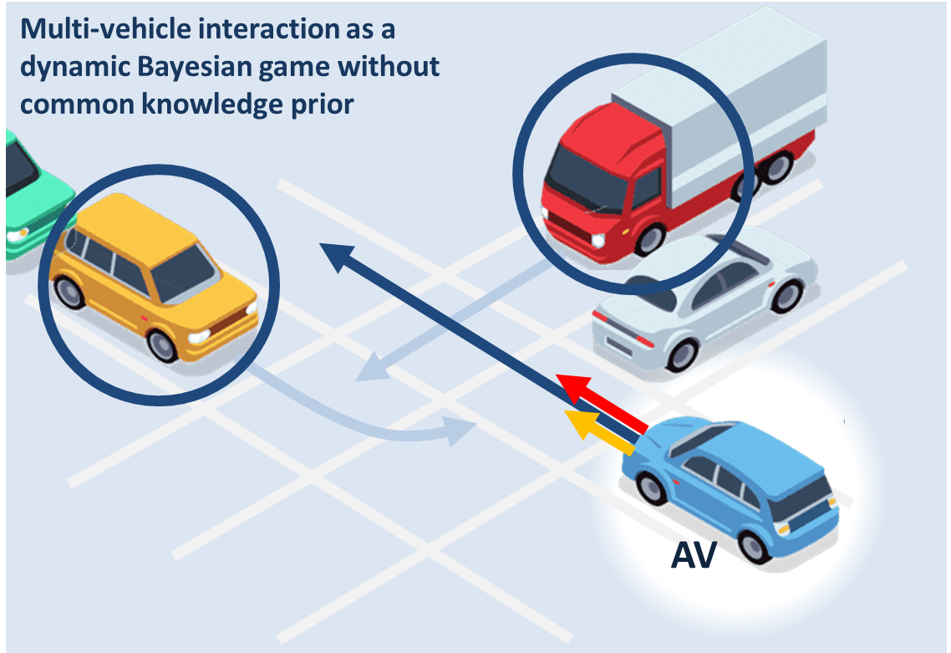
When Shall I Estimate Your Intent? Costs and Benefits of Intent Inference in Multi-Agent Interactions | Motivation
Motivation
Multi vehicle interactions are dynamic games with incomplete-information
Parameter estimation and motion planning
Computing Perfect Bayesian Equilibrium (PBE) in real time is computationally expensive
Key Question
Do we need to run the intent inference at the same frequency as motion planning?
What is a good choice of trigger for intent inference?
Is empathy advantageous?
Berkeley INTERACTION dataset
Notes:
Combine with page 3
We try to address these three question with our reseach

Slide 3
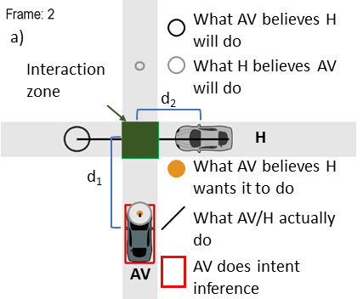
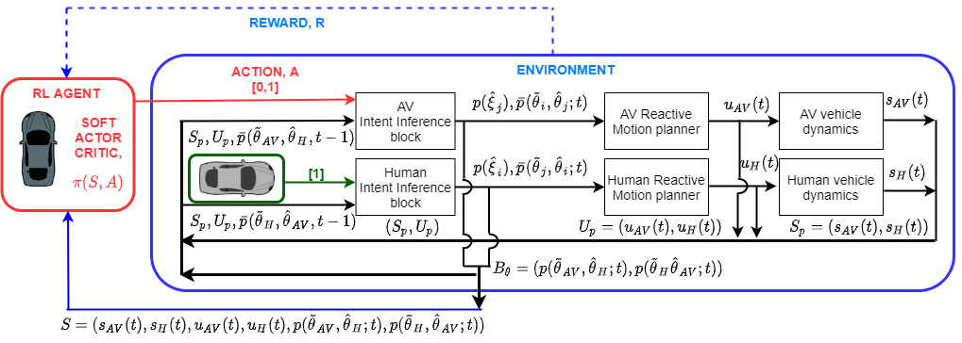
When Shall I Estimate Your Intent? Costs and Benefits of Intent Inference in Multi-Agent Interactions | Proposed Solution
Intermittent Empathetic Intent Inference
Reinforcement Learning agent takes in the physical and belief states and outputs if the agent should do intent inference or not.
Train our agent in an uncontrolled intersection scenario

Slide 4
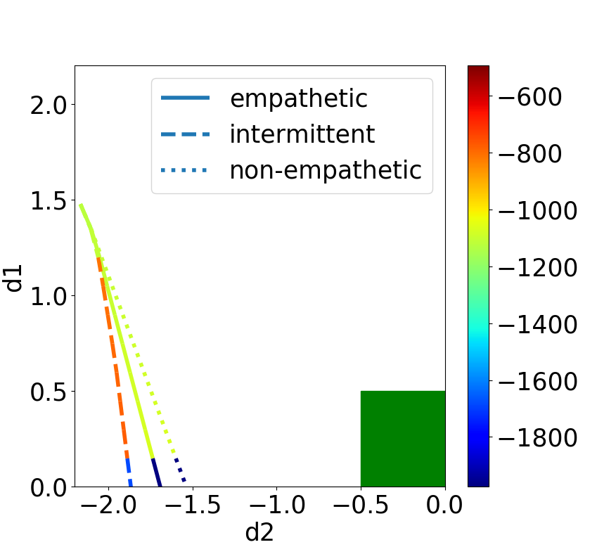
When Shall I Estimate Your Intent? Costs and Benefits of Intent Inference in Multi-Agent Interactions | Results
Is empathy advantageous?
Intermittent AV runs belief update until the intent of Human is determined
Empathetic AV decelerates in the beginning to create more courteous motion
Non-Empathetic AV maintains a constant velocity leading to closer distance between vehicles
Reward Graph for three intent inference case
Answer: YES

Slide 5
When Shall I Estimate Your Intent? Costs and Benefits of Intent Inference in Multi-Agent Interactions | Results
Frequency of intent inference: Cost and benefits
Parameters | Empathetic | Non-Empathetic | Intermittent
Memory (KB) | 3.11±0.28 | 2.95±0.95 | 1.27±0.34
Time (s) | 291.47±46.79 | 155.20±14.62 | 170.32±14.18
Value | -1.14e5 ±6.58e3 | -1.32e5 ±6.37e3 | -1.09e5 ±4.17e3
Distance | 1.43±0.05 | 1.33±0.07 | 1.42±0.15
Intermittent Intent Inference performs similar navigations as compared to the continuous inference algorithm while saving significant memory and time
Answer: NO

Slide 6
When Shall I Estimate Your Intent? Costs and Benefits of Intent Inference in Multi-Agent Interactions | Results
What is good choice of trigger for intent inference?
Introduce noise in the AV’s perceived state of the Human for intermittent intent inference
Noise Variance | Collision Ratio | Inference Ratio
0.0 | 0.100 | 1.0±0.0
0.00625 | 0.129 | 0.847±0.035
0.0125 | 0.133 | 0.155±0.089
0.025 | 0.145 | 0.562±0.064
0.05 | 0.140 | 0.810±0.051
In absence of noise, the AV does not collide with the Human vehicle
In presence of noise, the AV collides with the Human vehicle
Answer: NOT SURE
Notes:
What are the noise variances for these two cases?

Slide 7
When Shall I Estimate Your Intent? Costs and Benefits of Intent Inference in Multi-Agent Interactions | Conclusion
Conclusion
Intermittent Intent Inference has comparable performance to Empathetic Intent Inference done at every time step
Significant improvements are seen in memory used for algorithm and time for processing compared to baseline algorithms
In safety critical cases, intermittent intent inference shows inverse relationship between inference ratio and rate of collision.

Slide 8

When Shall I Estimate Your Intent? Costs and Benefits of Intent Inference in Multi-Agent Interactions
Thank you
February 27-28, 2020 | ARLINGTON, VIRGINIA
Sunny Amatya (Samatya@asu.edu)
Wenlong Zhang (Wenlong.Zhang@asu.edu)
https://home.riselab.info/
https://home.riselab.info/nri.html
This material is based on the work supported in part by the National Science Foundation (NSF) under NSF Award Number 1925403. Any opinions, findings and conclusions, or recommendations expressed in this material are those of the author(s) and, do not necessarily reflect those of the NSF.

